Slide 1
Avocado Dataset Analysis and ML Prediction
Project Work Term III

Slide 2
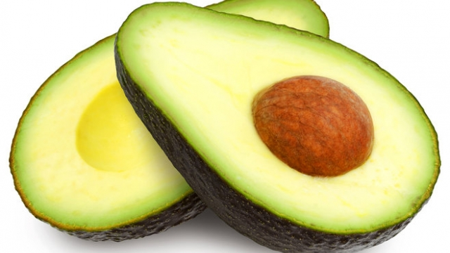
Avocados are a stone fruit with a creamy texture that grow in warm climates. Their potential health benefits include improving digestion, decreasing risk of depression, and protection against cancer.

Slide 3
Data Visualization
Organic vs. Conventional : The main difference between organic and conventional food products are the chemicals involved during production and processing. The interest in organic food products has been rising steadily over the recent years with new health super fruits emerging. Let's see if this is also the case with our dataset

Slide 4
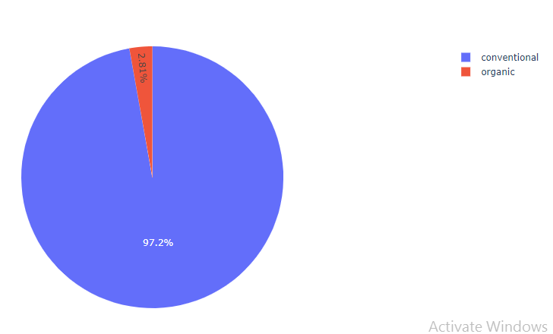
Which type of Avocados are more in demand (Conventional or Organic)?
Just over 2% of our dataset is organic. So looks like Conventional
is in more demand.

Slide 5
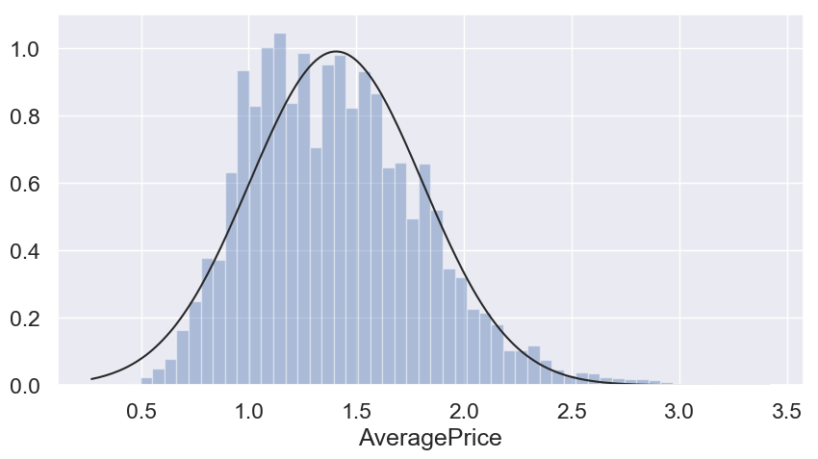
In which range Average price lies, what is distribution look like?
Average Price distribution shows that for most cases price of
avocado is between 1.1, 1.4

Slide 6
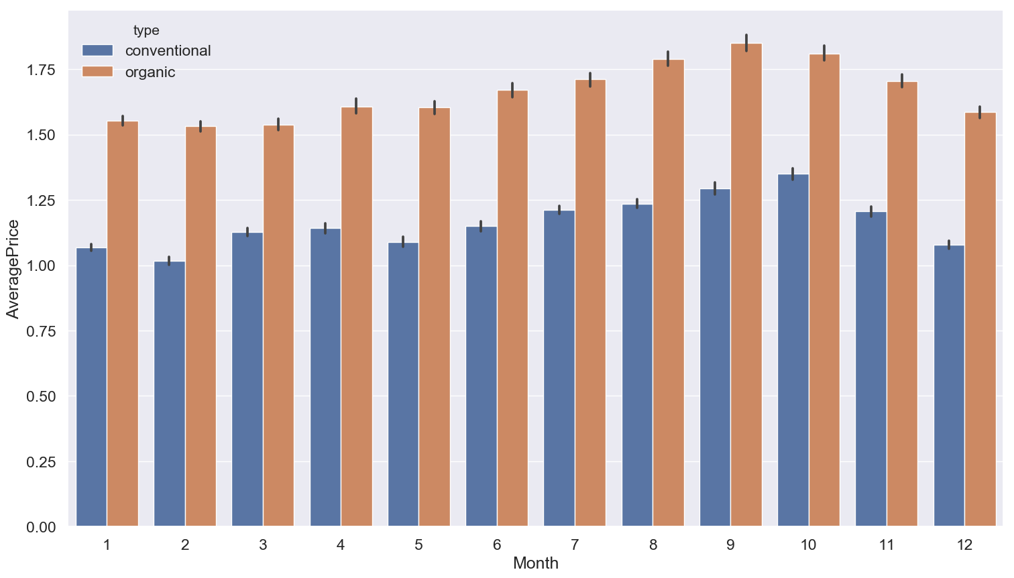
How Average price is distributed over the months for Conventional and Organic Types?
Looks like there was a hike between months 8 – 10 for
both Conventional and Organic type of Avocados prices.

Slide 7
Linear Regression
Let's apply Linear Regression Algorithm because our Target
variable 'AveragePrice' is continuous.
MAE: 0.23297133291665678
MSE: 0.09108802805350158
RMSE: 0.3018079323899582
The RMSE is low so we can say that we do have a good model,
but lets check to be more sure.

Slide 8
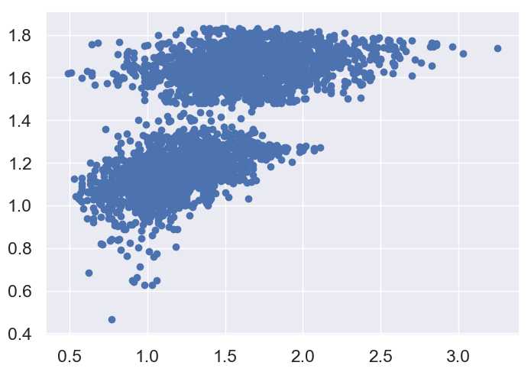
As we can see that we don't have a straight line, we are not sure that this is the best model we can apply on our data.

Slide 9
Decision Tree Regression model
MAE: 0.1373123287671233
MSE: 0.046453890410958903
RMSE: 0.2155316459616984
Very Nice, RMSE is lower than as compared to Linear Regression.

Slide 10
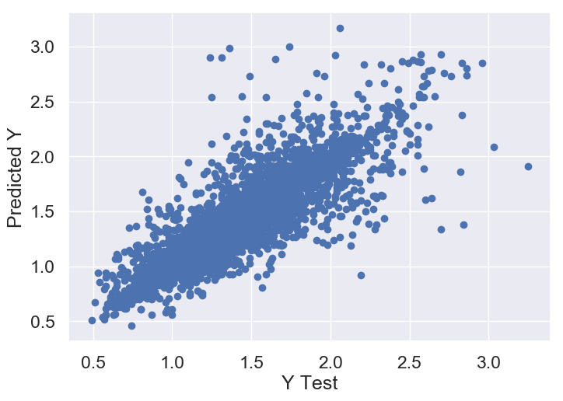
Nice, here we can see that we nearly have a straight line, in other words its better than the Linear regression model.

Slide 11
Random Forest Regressor Model
MAE: 0.10660109589041096
MSE: 0.024027293698630138
RMSE: 0.15500739885124884
Well as we can see the RMSE is lower than the two previous
models, so the Random Forest Regressor is the best model in
this case.

Slide 12
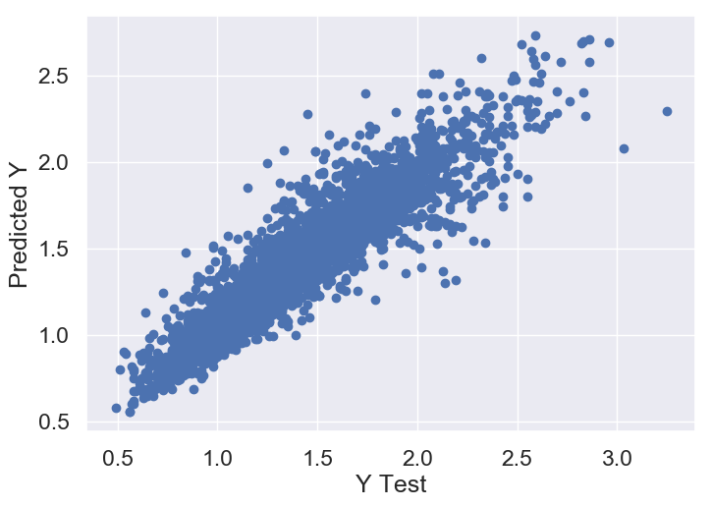
Here we can see that data points are very close to straight line. It is considered to be good model because RMSE is very less “0.15”

Slide 13
Conclusions
Used Pandas and other plotting libraries like matplotlib, plotly and seaborn for EDA.
Used profiler for data cleaning and identifying missing and incorrect values present in the data.
Used dummification for categorical values like type.
The most important inference drawn from all this analysis is, I get to know what are the features on which price is highly correlated with.
Used various algorithms to know which model will work better with the help of low RMSE scores.
This project helped me to gain lots of insights on how to choose the best model for prediction.
Also get to know how to use Linear Regression, Decision Tree and Random Forest models to fine tune the predictions.

